Slide 1






Foundations of
Quantum Information Science (QIS 102)
Dave Biersach
Brookhaven National Laboratory
dbiersach@bnl.gov
Session 12
Classical
Wave Equations

Slide 2
Session 12 – Part 1 of 2 – Topics
Review Newton's Binomial Theorem
Extract Square Roots using Newton's Series
Compare the Rate of Convergence of Binomial Expansions
Study Newton's Derivation of the Power Series for Sine
Derive and Visualize the Taylor Series for Fractional Roots
Review the critical parts of a sinusoidal transverse wave
Appreciate the effect of sampling rate on aliasing
Understand the Nyquist Sampling Theorem

Slide 3
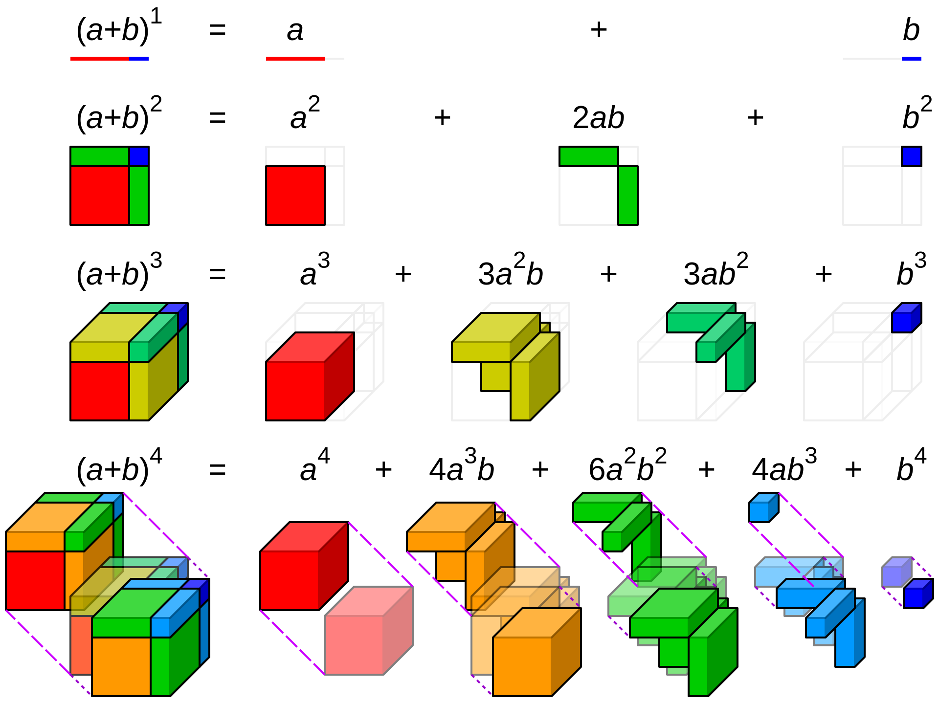
Polynomial Expansion

Slide 4
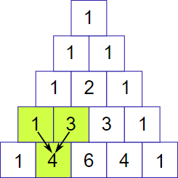
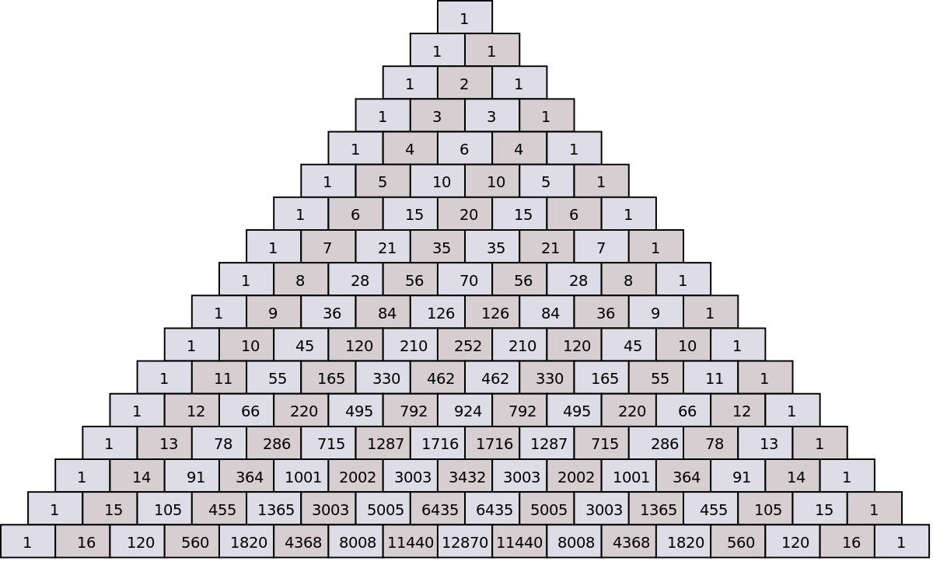
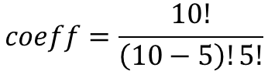
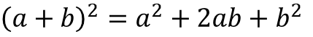
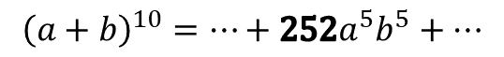
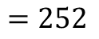
Pascal's Triangle & Combinations
$${\left(a+b\right)}^{2}=a^{2}+2ab+b^{2}$$
$${\left(a+b\right)}^{3}=a^{3}+3a^{2}b+3ab^{2}+b^{3}$$
$${\left(a+b\right)}^{4}=a^{4}+4a^{3}b+6a^{2}b^{2}+4ab^{3}+b^{4}$$
Row 0
Column 0
$$coeff=\frac{10!}{\left(10−5\right)!5!}$$
5
$$=252$$
10
$${\left(a+b\right)}^{10}=⋯+252a^{5}b^{5}+⋯$$

Slide 5
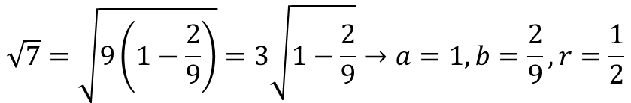
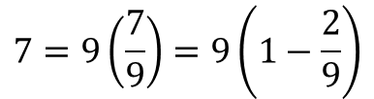
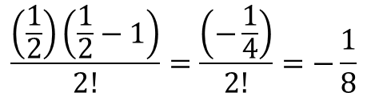
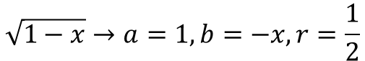

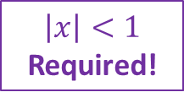
Newton's Generalized Binomial Theorem
$${\left(a+b\right)}^{r}=a^{r}+ra^{r−1}b+\frac{r(r−1)}{2!}a^{r−2}b^{2}+\frac{r(r−1)(r−2)}{3!}a^{r−3}b^{3}+⋯$$
$$\sqrt{1−x}→a=1,b=−x,r=\frac{1}{2}$$
$$\frac{\left(\frac{1}{2}\right)\left(\frac{1}{2}−1\right)}{2!}=\frac{\left(−\frac{1}{4}\right)}{2!}=−\frac{1}{8}$$
$$\sqrt{1−x}=1−\frac{1}{2}x−\frac{1}{8}x^{2}−\frac{1}{16}x^{3}−\frac{5}{128}x^{4}−\frac{7}{256}x^{5}+⋯$$
$$\left|x\right|<1$$
Required!
$$7=9\left(\frac{7}{9}\right)=9\left(1−\frac{2}{9}\right)$$
$$\sqrt{7}=?$$
$$\sqrt{7}=\sqrt{9\left(1−\frac{2}{9}\right)}=3\sqrt{1−\frac{2}{9}}→a=1,b=\frac{2}{9},r=\frac{1}{2}$$

Slide 6
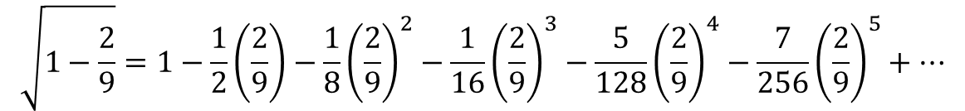
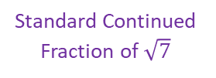
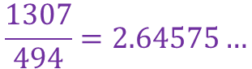
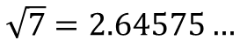
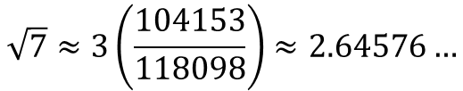
Newton's Generalized Binomial Theorem
$${\left(a+b\right)}^{r}=a^{r}+ra^{r−1}b+\frac{r(r−1)}{2!}a^{r−2}b^{2}+\frac{r(r−1)(r−2)}{3!}a^{r−3}b^{3}+⋯$$
$$\sqrt{1−x}→a=1,b=−x,r=\frac{1}{2}$$
$$\frac{\left(\frac{1}{2}\right)\left(\frac{1}{2}−1\right)}{2!}=\frac{\left(−\frac{1}{4}\right)}{2!}=−\frac{1}{8}$$
$$\sqrt{1−x}=1−\frac{1}{2}x−\frac{1}{8}x^{2}−\frac{1}{16}x^{3}−\frac{5}{128}x^{4}−\frac{7}{256}x^{5}+⋯$$
$$\left|x\right|<1$$
Required!
$$\sqrt{1−\frac{2}{9}}=1−\frac{1}{2}\left(\frac{2}{9}\right)−\frac{1}{8}{\left(\frac{2}{9}\right)}^{2}−\frac{1}{16}{\left(\frac{2}{9}\right)}^{3}−\frac{5}{128}{\left(\frac{2}{9}\right)}^{4}−\frac{7}{256}{\left(\frac{2}{9}\right)}^{5}+⋯$$
$$\sqrt{7}≈3\left(\frac{104153}{118098}\right)≈2.64576…$$
Standard Continued Fraction of $\sqrt{7}$
$$\sqrt{7}=2.64575…$$
$$\frac{1307}{494}=2.64575…$$

Slide 7
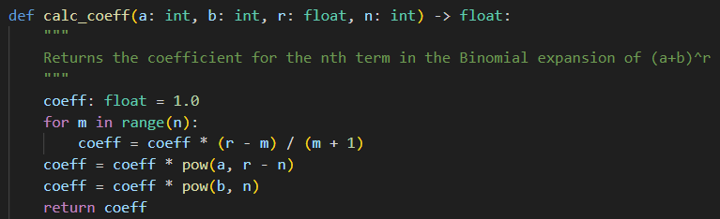
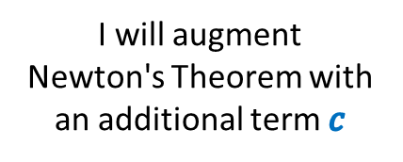
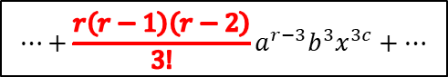
Open binomial_sqrt.py
①
②
③
$$⋯+\frac{r\left(r−1\right)\left(r−2\right)}{3!}a^{r−3}b^{3}x^{3c}+⋯$$
④
⑤
⑥
⑦
I will augment
Newton's Theorem with an additional term $c$
$${\left(a+bx^{c}\right)}^{r}=a^{r}+ra^{r−1}bx^{c}+\frac{r(r−1)}{2!}a^{r−2}b^{2}x^{2c}+\frac{r(r−1)(r−2)}{3!}a^{r−3}b^{3}x^{3c}+⋯$$

Slide 8
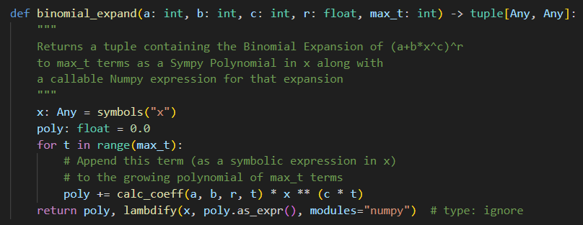
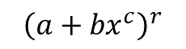
View binomial_sqrt.py
①
②
$${\left(a+{bx}^{c}\right)}^{r}$$
③
④
A SymPy Symbolic Expression
A NumPy Callable
Function
$${\left(a+bx^{c}\right)}^{r}=a^{r}+ra^{r−1}bx^{c}+\frac{r(r−1)}{2!}a^{r−2}b^{2}x^{2c}+\frac{r(r−1)(r−2)}{3!}a^{r−3}b^{3}x^{3c}+⋯$$

Slide 9
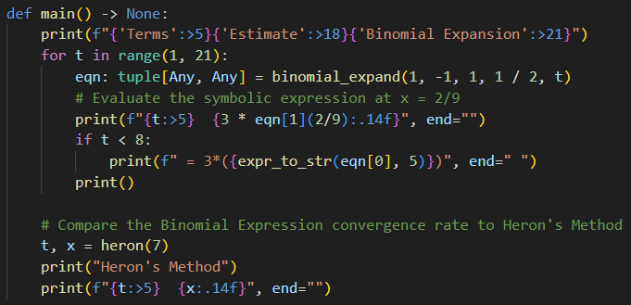
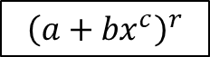
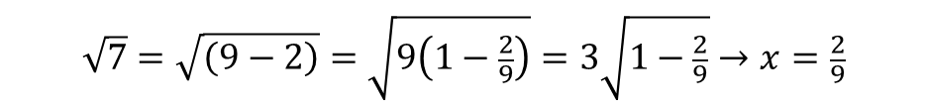
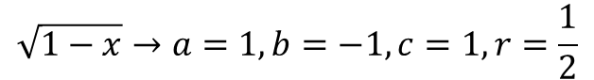
View binomial_sqrt.py
①
②
We want to display only up to the first 8 terms of this power series
$${\left(a+{bx}^{c}\right)}^{r}$$
③
④
⑤
$$\sqrt{1−x}→a=1,b=−1,c=1,r=\frac{1}{2}$$
$$\sqrt{1−x}=1−\frac{1}{2}x−\frac{1}{8}x^{2}−\frac{1}{16}x^{3}−\frac{5}{128}x^{4}−\frac{7}{256}x^{5}+⋯$$
$$\sqrt{7}=\sqrt{\left(9−2\right)}=\sqrt{9\left(1−\frac{2}{9}\right)}=3\sqrt{1−\frac{2}{9}}→x=\frac{2}{9}$$
9

Slide 10
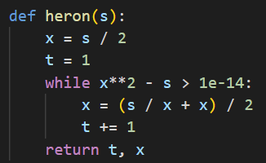
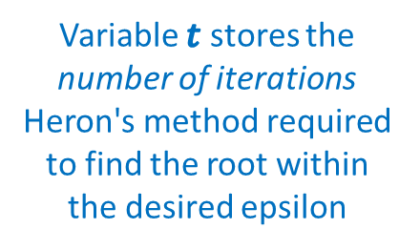
View binomial_sqrt.py
⑥
Variable $t$ stores the number of iterations Heron's method required to find the root within the desired epsilon

Slide 11
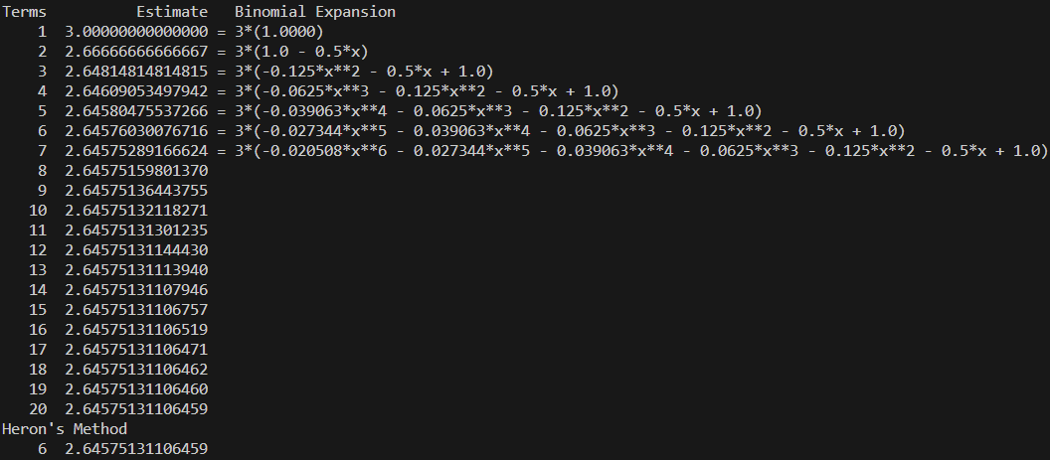
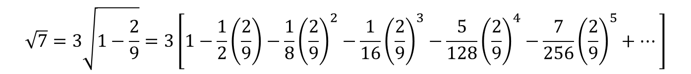
Run binomial_sqrt.py
①
$$\sqrt{1−x}=1−\frac{1}{2}x−\frac{1}{8}x^{2}−\frac{1}{16}x^{3}−\frac{5}{128}x^{4}−\frac{7}{256}x^{5}+⋯$$
②
③
Heron's Method Converges Much Faster!
$$\sqrt{7}=3\sqrt{1−\frac{2}{9}}=3\left[1−\frac{1}{2}\left(\frac{2}{9}\right)−\frac{1}{8}{\left(\frac{2}{9}\right)}^{2}−\frac{1}{16}{\left(\frac{2}{9}\right)}^{3}−\frac{5}{128}{\left(\frac{2}{9}\right)}^{4}−\frac{7}{256}{\left(\frac{2}{9}\right)}^{5}+⋯\right]$$

Slide 12
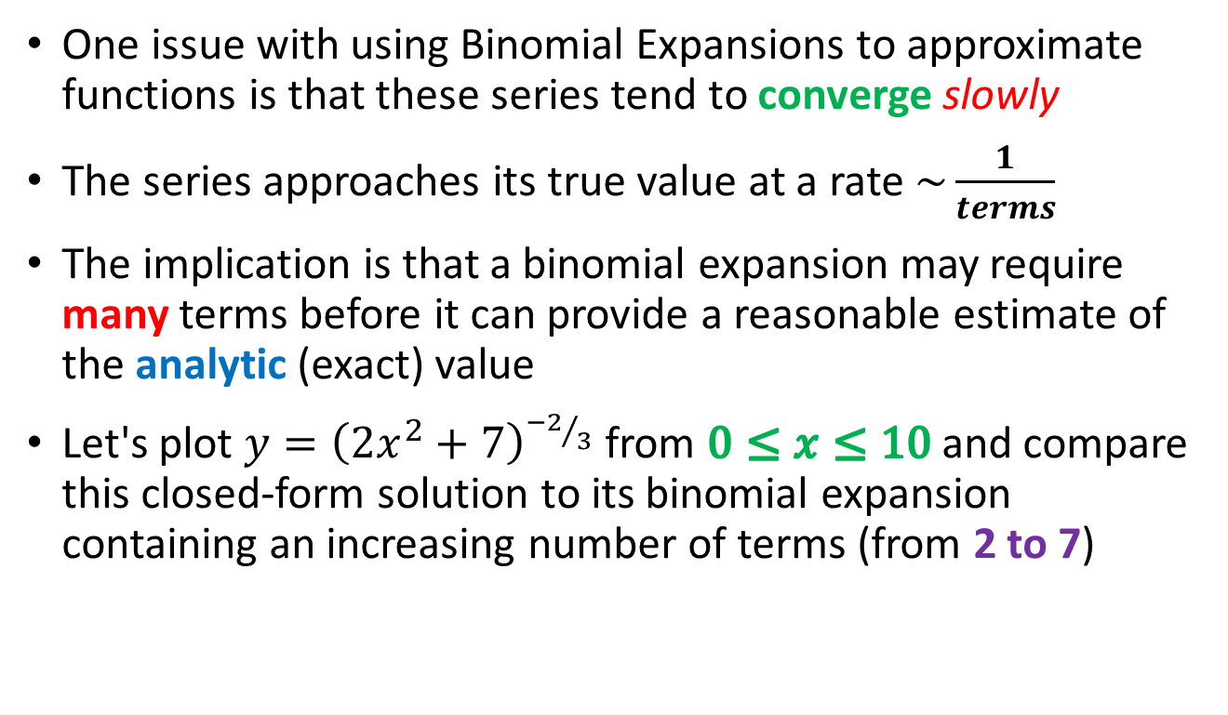
Convergence of Binomial Expansions
One issue with using Binomial Expansions to approximate functions is that these series tend to converge slowly
The series approaches its true value at a rate $\sim \frac{1}{terms}$
The implication is that a binomial expansion may require many terms before it can provide a reasonable estimate of the analytic (exact) value
Let's plot $y={\left(2x^{2}+7\right)}^{{−2}/3}$ from $0≤x≤10$and compare this closed-form solution to its binomial expansion containing an increasing number of terms (from 2 to 7)

Slide 13
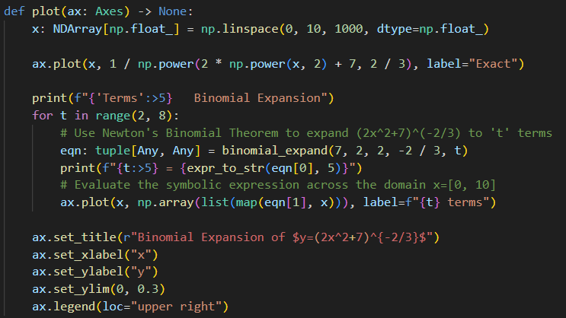
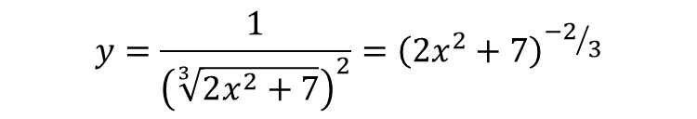
Open newton_binomial.py
①
②
③
④
⑤
⑥
⑦
$$y=\frac{1}{{\left(\sqrt[3]{2x^{2}+7}\right)}^{2}}={\left(2x^{2}+7\right)}^{{−2}/3}$$
$${\left(a+bx^{c}\right)}^{r}={\left(2x^{2}+7\right)}^{{−2}/3}→a=7,b=2,c=2,r=−\frac{2}{3}$$

Slide 14
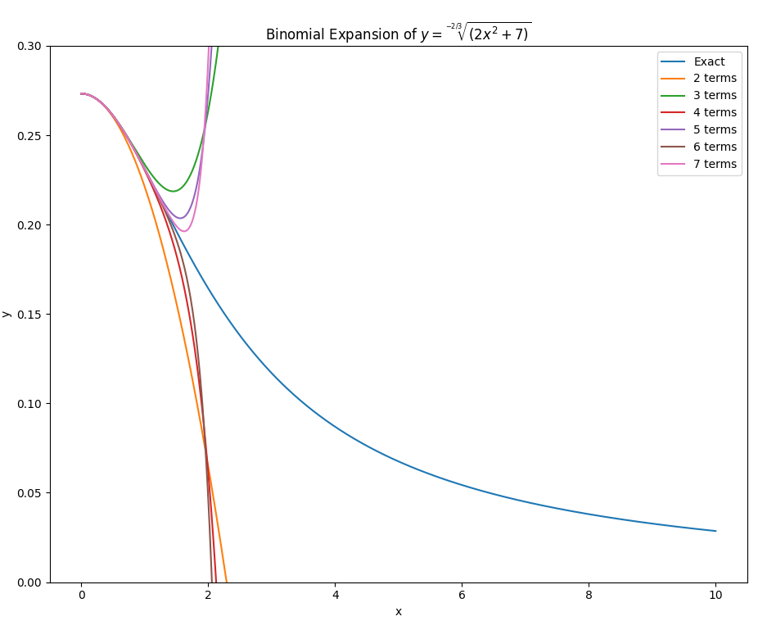
Run newton_binomial.py
These are the binomial expansions with successively more terms
Rate of Convergence to exact solution is very slow
This is the exact curve

Slide 15
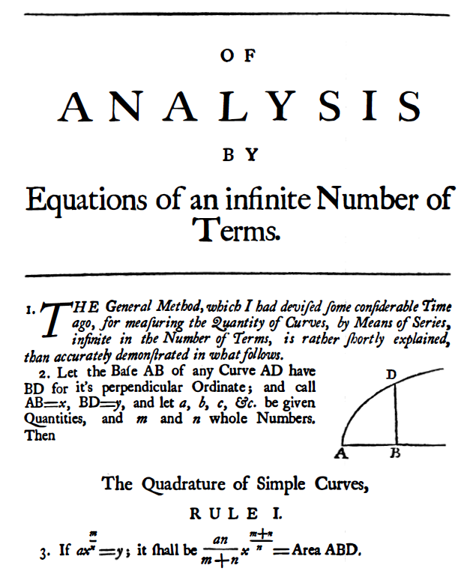
From Binomial Theorem to Calculus
Isaac Newton
1669
Salem Witch Trials
1693

Slide 16
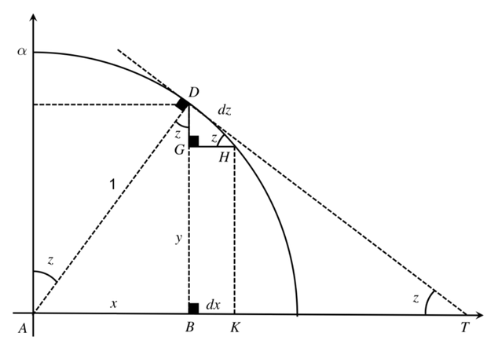
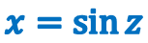
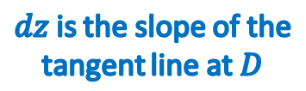
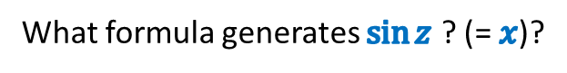
Newton's Sine Formula
What formula generates $\sin{z}$ ? (= $x$)?
$dz$ is the slope of the tangent line at $D$
$$x=\sin{z}$$

Slide 17
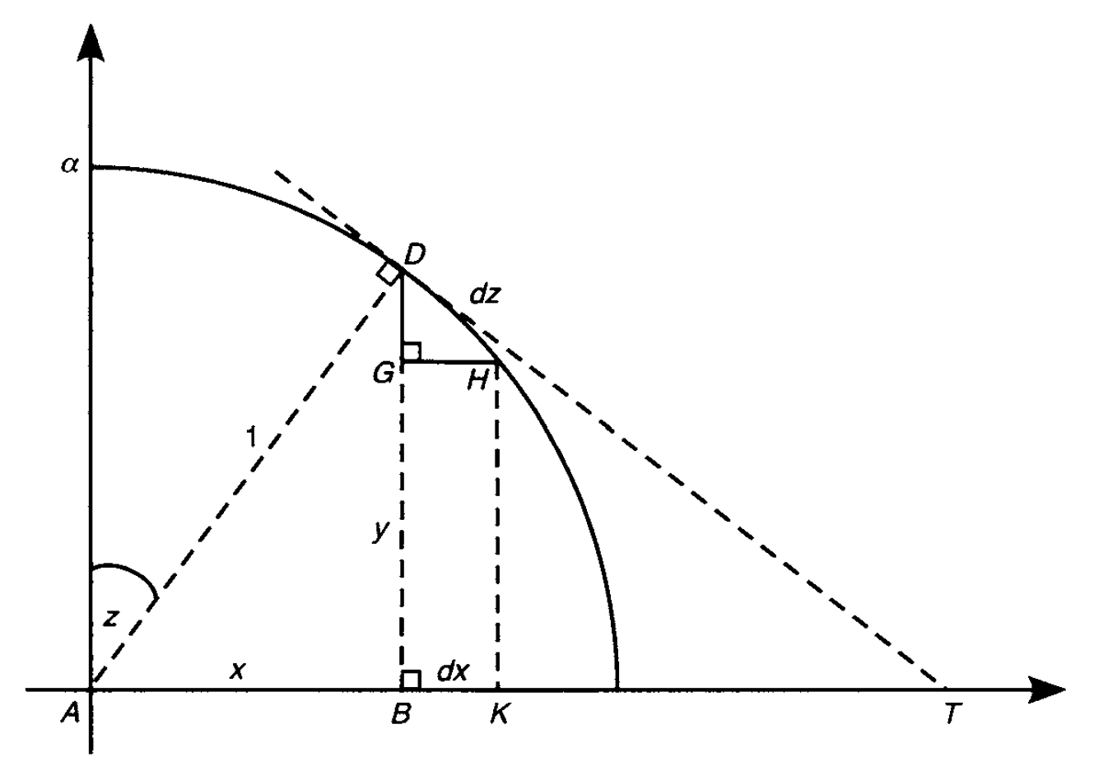
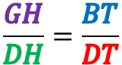
Newton's Sine Formula
Similar Triangles
$$\frac{GH}{DH}=\frac{BT}{DT}$$

Slide 18
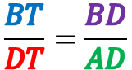
Newton's Sine Formula
Similar Triangles
$$\frac{BT}{DT}=\frac{BD}{AD}$$

Slide 19
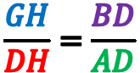
Newton's Sine Formula
Similar Triangles
$$\frac{GH}{DH}=\frac{BD}{AD}$$

Slide 20
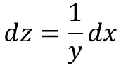
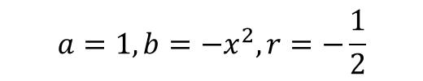
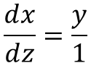
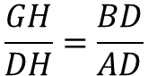
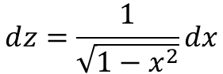
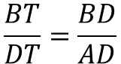
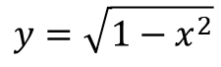


Newton's Sine Formula
Similar Triangles
$$\frac{GH}{DH}=\frac{BT}{DT}$$
$$\frac{BT}{DT}=\frac{BD}{AD}$$
$$\frac{GH}{DH}=\frac{BD}{AD}$$
$$\frac{ⅆx}{ⅆz}=\frac{y}{1}$$
Unit Circle
$$x^{2}+y^{2}=1$$
$$ⅆz=\frac{1}{y}dx$$
$$y=\sqrt{1−x^{2}}$$
$$ⅆz=\frac{1}{\sqrt{1−x^{2}}}dx$$
$$a=1,b=−x^{2},r=−\frac{1}{2}$$
$${\left(a+b\right)}^{r}=a^{r}+ra^{r−1}b+\frac{r(r−1)}{2!}a^{r−2}b^{2}+\frac{r(r−1)(r−2)}{3!}a^{r−3}b^{3}+⋯$$

Slide 21





Newton's Sine Formula
$${\left(a+b\right)}^{r}=a^{r}+ra^{r−1}b+\frac{r(r−1)}{2!}a^{r−2}b^{2}+\frac{r(r−1)(r−2)}{3!}a^{r−3}b^{3}+⋯$$
$$ⅆz=\frac{ⅆx}{\sqrt{1−x^{2}}}$$
$$a=1,b=−x^{2},r=−\frac{1}{2}$$
$$\frac{\left(−\frac{1}{2}\right)\left(−\frac{1}{2}−1\right)}{2!}=\frac{\left(\frac{3}{4}\right)}{2!}=\frac{3}{8}$$
$$ⅆz=\frac{1}{\sqrt{1−x^{2}}}dx=1+\frac{1}{2}x^{2}+\frac{3}{8}x^{4}+\frac{5}{18}x^{6}+\frac{35}{128}x^{8}⋯dx$$
$$z(x)=\int_{0}^{x}{\left(1+\frac{1}{2}x^{2}+\frac{3}{8}x^{4}+\frac{5}{18}x^{6}+\frac{35}{128}x^{8}⋯\right)ⅆx}$$
$$z(x)=x+\frac{1}{6}x^{3}+\frac{3}{40}x^{5}+\frac{5}{112}x^{7}+\frac{35}{1152}x^{9}⋯$$

Slide 22




Newton's Sine Formula
$$z(x)=x+\frac{1}{6}x^{3}+\frac{3}{40}x^{5}+\frac{5}{112}x^{7}+\frac{35}{1152}x^{9}⋯$$
$$arcsin(x)=x+\frac{1}{6}x^{3}+\frac{3}{40}x^{5}+\frac{5}{112}x^{7}+\frac{35}{1152}x^{9}⋯$$
$$x=sin\left(z\right)=z^{−1}(x)$$
$$z$$
How do we invert an infinite series?
How do we get $x$ in terms of $z$ ?
Remember, $∠z$ is the angle opposite side $x$ in $⊿ADB$ thus $\sin{z}=x$ therefore
$$z=arcsin\left(x\right)$$

Slide 23




Newton's Sine Formula
$$z(x)=x+\frac{1}{6}x^{3}+\frac{3}{40}x^{5}+\frac{5}{112}x^{7}+\frac{35}{1152}x^{9}⋯$$
$$arcsin(x)=x+\frac{1}{6}x^{3}+\frac{3}{40}x^{5}+\frac{5}{112}x^{7}+\frac{35}{1152}x^{9}⋯$$
$$\sin\left(x\right)=z^{−1}(x)$$
How do we invert an infinite series?
$$f\left(x\right)=Poly\left(x\right)−z=0$$
$$s=z$$
Expand $f(s+p)$, drop all $p^{2+}$ terms, solve for $p$
$t$ = Lowest power $z$ term in numerator
$$s=s+t$$

Slide 24




Newton's Sine Formula
$$z(x)=x+\frac{1}{6}x^{3}+\frac{3}{40}x^{5}+\frac{5}{112}x^{7}+\frac{35}{1152}x^{9}⋯$$
$$\left(z+p\right)+\frac{1}{6}{\left(z+p\right)}^{3}+\frac{3}{40}{\left(z+p\right)}^{5}+⋯−z=0$$
$$p=\frac{−\frac{1}{6}z^{3}−\frac{3}{40}z^{5}}{1+\frac{1}{2}z^{2}+\frac{3}{8}z^{4}}+⋯$$
$$t=−\frac{1}{6}z^{3}$$
$$f\left(x\right)=Poly\left(x\right)−z=0$$
$$s=z$$
$$s=z−\frac{1}{6}z^{3}$$
Expand $f(s+p)$, drop all $p^{2+}$ terms, solve for $p$
$t$ = Lowest power $z$ term in numerator
$$s=s+t$$

Slide 25




Newton's Sine Formula
$$z(x)=x+\frac{1}{6}x^{3}+\frac{3}{40}x^{5}+\frac{5}{112}x^{7}+\frac{35}{1152}x^{9}⋯$$
s
$$\left(z−\frac{1}{6}z^{3}+p\right)+\frac{1}{6}{\left(z−\frac{1}{6}z^{3}+p\right)}^{3}+\frac{3}{40}{\left(z−\frac{1}{6}z^{3}+p\right)}^{5}+⋯−z=0$$
$$p=\frac{\frac{1}{120}z^{5}−\frac{7}{144}z^{7}}{1+\frac{1}{2}z^{2}+\frac{5}{24}z^{4}}+⋯$$
$$t=\frac{1}{120}z^{5}$$
$$f\left(x\right)=Poly\left(x\right)−z=0$$
$$s=z$$
$$s=z−\frac{1}{6}z^{3}+\frac{1}{120}z^{5}$$
Expand $f(s+p)$, drop all $p^{2+}$ terms, solve for $p$
$t$ = Lowest power $z$ term in numerator
$$s=s+t$$

Slide 26



Newton's Sine Formula
$$z(x)=x+\frac{1}{6}x^{3}+\frac{3}{40}x^{5}+\frac{5}{112}x^{7}+\frac{35}{1152}x^{9}⋯$$
s
$$\left(z−\frac{1}{6}z^{3}+\frac{1}{120}z^{5}+p\right)+\frac{1}{6}{\left(z−\frac{1}{6}z^{3}+\frac{1}{120}z^{5}+p\right)}^{3}+\frac{3}{40}{\left(z−\frac{1}{6}z^{3}+\frac{1}{120}z^{5}+p\right)}^{5}+⋯−z=0$$
$$p=\frac{−\frac{1}{5040}z^{7}−\frac{157}{5184}z^{9}}{1+\frac{1}{2}z^{2}+\frac{5}{24}z^{4}}+⋯$$
$$t=−\frac{1}{5040}z^{7}$$
$$f\left(x\right)=Poly\left(x\right)−z=0$$
$$s=z$$
$$s=z−\frac{1}{6}z^{3}+\frac{1}{120}z^{5}−\frac{1}{5040}z^{7}$$
Expand $f(s+p)$, drop all $p^{2+}$ terms, solve for $p$
$t$ = Lowest power $z$ term in numerator
$$s=s+t$$

Slide 27



Newton's Sine Formula
$$z(x)=x+\frac{1}{6}x^{3}+\frac{3}{40}x^{5}+\frac{5}{112}x^{7}+\frac{35}{1152}x^{9}⋯$$
$$arcsin(x)=x+\frac{1}{6}x^{3}+\frac{3}{40}x^{5}+\frac{5}{112}x^{7}+\frac{35}{1152}x^{9}⋯$$
$$\sin\left(z\right)=z^{−1}(x)$$
$$z$$
How do we invert an infinite series?
$$x=sin\left(z\right)$$
$$\sin\left(z\right)=z−\frac{1}{6}z^{3}+\frac{1}{120}z^{5}−\frac{1}{5040}z^{7}+\frac{1}{362880}z^{9}+⋯$$
$$arcsin\left(x\right)=z$$

Slide 28




Newton's Sine Formula
$$\sin\left(θ\right)=θ−\frac{1}{6}θ^{3}+\frac{1}{120}θ^{5}−\frac{1}{5040}θ^{7}+\frac{1}{362880}θ^{9}+⋯$$
This 1st Derivative also checks out!
$$\cos\left(θ\right)=1−\frac{1}{2}θ^{2}+\frac{1}{24}θ^{4}−\frac{1}{720}θ^{6}+\frac{1}{40320}θ^{8}+⋯$$
$${\cos\left(θ\right)}^{′}=0−\frac{2}{2}θ+\frac{4}{24}θ^{3}−\frac{6}{720}θ^{5}+\frac{8}{40320}θ^{7}+⋯$$
$${\cos\left(θ\right)}^{′}=−θ+\frac{1}{6}θ^{3}−\frac{1}{120}θ^{5}+\frac{1}{5040}θ^{7}+⋯$$
$${\cos\left(θ\right)}^{′}=\left(−1\right)\left(θ−\frac{1}{6}θ^{3}+\frac{1}{120}θ^{5}−\frac{1}{5040}θ^{7}+⋯ \right)$$
Isaac Newton
(1643-1727)
$${\cos\left(θ\right)}^{′}=−\sin\left(θ\right)$$
☺

Slide 29

From the Binomial Theorem to Calculus
Isaac Newton (1669, age 26)

Slide 30

Taylor Series
https://www.youtube.com/watch?v=3d6DsjIBzJ4

Slide 31

Taylor Series
https://www.youtube.com/watch?v=3d6DsjIBzJ4

Slide 32

Taylor Series
https://www.youtube.com/watch?v=3d6DsjIBzJ4

Slide 33

Taylor Series
https://www.youtube.com/watch?v=3d6DsjIBzJ4

Slide 34

Taylor Series
https://www.youtube.com/watch?v=3d6DsjIBzJ4

Slide 35

Taylor Series
https://www.youtube.com/watch?v=3d6DsjIBzJ4

Slide 36

Taylor Series
https://www.youtube.com/watch?v=3d6DsjIBzJ4

Slide 37


Taylor Series
Brook Taylor
(1685-1731)
Integration by Parts

Slide 38



Taylor Series
$$\sin\left(θ\right)=\sum_{k=0}^{∞}{\frac{{\left(−1\right)}^{k}}{\left(2k+1\right)!}z^{2k+1}}$$
It is not obvious from these formulas that
$\frac{d}{dx}\sin{θ=\cos{θ}}$
Brook Taylor
(1685-1731)
$$\cos\left(θ\right)=\sum_{k=0}^{∞}{\frac{{\left(−1\right)}^{k}}{\left(2k\right)!}z^{2k}}$$
Generally, Taylor's Series will converge much faster than Newton's Binomial Expansion
Many physics derivations estimate an equation using a 3rd order Taylor Series – it is important to understand how this approximation is built!

Slide 39


Open taylor_series.py
①
②
Remove the "big-O" error estimate symbolic term
③
④
⑤
⑥
⑦
⑧

Slide 40




View taylor_series.py
$$f\left(x\right)=\cos{x}$$
$$f^{′}\left(x\right)=−\sin{x}$$
①
②
③
④
⑤
⑥
$$y_{n}=y_{n−1}+\left[f^{′}\left(x_{n−1}\right)\right]Δx$$
⑦
⑧

Slide 41

Run taylor_series.py
With only five terms, the Taylor series begins to diverge
Even with an equal # of terms, the Taylor series still tracks closer than Newton's
Euler's Method tracks longer than Taylor's series, but after 20 iterations, it too is no longer estimating well
This is the exact curve
①

Slide 42






Euler's Formula
$$\cos{θ}=1−\frac{θ^{2}}{2!}+\frac{θ}{4!}−\frac{θ^{6}}{6!}+\frac{θ^{8}}{8!}+…$$
$$\sin{θ}=θ−\frac{θ^{3}}{3!}+\frac{θ^{5}}{5!}−\frac{θ^{7}}{7!}+\frac{θ^{9}}{9!}+…$$
$$e^{x}=1+x+\frac{x^{2}}{2!}+\frac{x^{3}}{3!}+\frac{x^{4}}{4!}+\frac{x^{5}}{5!}+\frac{x^{6}}{6!}+\frac{x^{7}}{7!}…$$
$$e^{ix}=1+ix+\frac{{\left(ix\right)}^{2}}{2!}+\frac{{\left(ix\right)}^{3}}{3!}+\frac{{\left(ix\right)}^{4}}{4!}+\frac{{\left(ix\right)}^{5}}{5!}+\frac{{\left(ix\right)}^{6}}{6!}+\frac{{\left(ix\right)}^{7}}{7!}+…$$
$$e^{ix}=1+ix−\frac{x^{2}}{2!}−i\frac{x^{3}}{3!}+\frac{x^{4}}{4!}+i\frac{x^{5}}{5!}−\frac{x^{6}}{6!}−i\frac{x^{7}}{7!}+……$$
$$e^{iθ}=\left(1−\frac{θ^{2}}{2!}+\frac{θ^{4}}{4!}−\frac{θ^{6}}{6!}\right)+i\left(θ−\frac{θ^{3}}{3!}+\frac{θ^{5}}{5!}−\frac{θ^{7}}{7!}\right)+…$$
$$e^{iθ}=\cos{θ}+i\sin{θ}$$

Slide 43
Most of Science is Waves
Biology
Chemistry
Physics
Math
Electrical
Magnetic
Acoustic
Heat Flow
Vibrational
Torsional
Nuclear / Quantum
Gravitational
Oceanic / Tidal
Orbital Precession
Springs
Pendulums
Tomography
Stock Market
Economics
Astronomical
Fluid Dynamics
Earthquakes
AC / DC
AM / FM
Speech
Heartbeats
It is important that you develop a keen
understanding of the mathematics of waves!

Slide 44

Wave Types

Slide 45

Transverse Wave Components
Wavelength is across distance
Period
is across time

Slide 46












Transverse Wave Components
$$2π=\frac{radians}{cycle}$$
$$Angular velocity=ω=\frac{radians}{time}$$
$$ω=\left(\frac{radians}{cycle}\right)\left(\frac{cycle}{time}\right)$$
$$Period=T=\frac{time}{cycle}$$
$$ω=2πf$$
$$Frequency=f=\frac{cycle}{time}=\frac{1}{T}$$
$$Wave velocity=v=\frac{distance}{time}$$
$$Wavelength=λ=\frac{distance}{cycle}$$
$$v=\left(\frac{distance}{cycle}\right)\left(\frac{cycle}{time}\right)$$
$$Wavenumber=k=\frac{2π}{λ}$$
$$v=λf$$

Slide 47









Transverse Wave Components
$$y=\sin{x}$$
$$2π$$
$y=\sin{x}$ has a wavelength $λ=2π$
$$\frac{π}{2}$$
$$\frac{π}{2}+2π$$
$$sin\left(\frac{π}{2}\right){=1}$$
$$2π$$
Crest to Crest
1
0
$$\sin\left(\frac{π}{2}+2π\right)=\sin{\frac{π}{2}\cos{2π+\cos{\frac{π}{2}\sin{2π}}}=1}$$

Slide 48


Transverse Wave Components
$y=\sin{x}$ has a wavelength $λ=2π$
if k = 1
$$Wavenumber=k=\frac{2π}{λ}$$
$$y=\sin{kx}⇒λ=\frac{2π}{k}$$
Example: $\frac{5 (distance)}{2 (crests)}→λ=2.5⇒k=\frac{2π}{\left(\frac{5}{2}\right)}⇒k=\frac{4π}{5}⇒y=\sin{\frac{4π}{5}x}$
2 crests per every 5 lengths

Slide 49

Known Wave Aliasing
Write Python code to display a graph of the function:
$$y={\left.\sin\left(\frac{4π}{5}x\right)\right|}_{0}^{20}$$
High-level approach:
Subdivide the specified domain into $n$ intervals
Calculate the range $y_{i}$ at each domain $x_{i}$ value
Store the domain and range values in NumPy arrays
Pass the two arrays to Matplotlib so it can draw a line graph connecting successive $\left(x_{i},y_{i}\right)$ points in the curve
2 crests per every 5 lengths

Slide 50


Open nyquist_known.py
①
②
③
④
⑤
⑥
⑦
⑧
⑨
⑩

Slide 51




Run nyquist_known.py
$$y={\left.\sin\left(\frac{4π}{5}x\right)\right|}_{0}^{20}$$
$$\frac{20}{λ}=8 crests$$
$$λ=\frac{5}{2}=2.5$$

Slide 52


Edit nyquist_known.py
①
Edit the last value in the tuple so $n=15$ intervals

Slide 53

Run nyquist_known.py

Slide 54


Edit nyquist_known.py
①
Edit the last value in the tuple so $n=17$ intervals

Slide 55

Run nyquist_known.py

Slide 56


Edit nyquist_known.py
①
Edit the last value in the tuple so $n=16$ intervals

Slide 57


Run nyquist_known.py
What is the specific relationship between the sinusoid’s$λ$and the graph’s $Δx$ that causes this kind of catastrophic aliasing?

Slide 58


Edit nyquist_known.py
①
Edit the last value in the tuple so $n=31$ intervals

Slide 59


Run nyquist_known.py
Does catastrophic aliasing occur for any value $n≠16$?

Slide 60


Edit nyquist_known.py
①
Edit the last value in the tuple so $n=33$ intervals

Slide 61


Run nyquist_known.py
How can $n$ be chosen to avoid catastrophic aliasing?

Slide 62


Edit nyquist_known.py
①
Edit the last value in the tuple so $n=32$ intervals

Slide 63


Run nyquist_known.py
At $n=32$ the graph is coarse but at least now it reaches its full $±1$ range

Slide 64


Nyquist Sampling Theorem
To minimize aliasing (data loss), if you know $λ$ ahead of time, set $n=\left(\frac{2}{λ}\right)\left(b−a\right)\left(2r\right), where r∈ℤ^{+}$
This rule is the Nyquist Sampling Theorem
You need at least 2x as many samples as the highest frequency you intend to capture
This wave is under sampled (n is too low!)

Slide 65

Unknown Wave Aliasing
You have an experiment that exhibits a periodic behavior having a theoretical frequency of 210 Hz
Therefore, to meet the Nyquist minimum, you should take at least 420 samples/sec to capture its wavelike nature

Slide 66

Open nyquist_unknown.py
①

Slide 67

Run nyquist_unknown.py

Slide 68


Nyquist Sampling Theorem
Enough! We will now take 14x more samples!

Slide 69


Edit nyquist_unknown.py
①
Edit the last value in the tuple so $n=2940$ intervals

Slide 70

Run nyquist_unknown.py

Slide 71

Nyquist Sampling Theorem
What if we take one less sample?

Slide 72


Edit nyquist_unknown.py
①
Edit the last value in the tuple so $n=2939$ intervals

Slide 73

Run nyquist_unknown.py
Taking one less sample made all the difference – why?
Now we can finally see the wave in its true form

Slide 74

Nyquist Sampling Theorem
If you don’t know (a priori) the exact frequency of an unknown sinusoid, then to minimize the chance of aliasing, is it best to set $n$ to a prime number $≥2×b$? Why?
What happens if your sampling rate aligns precisely with the sampled wave's oscillatory period?
What happens if, by pure lousy luck, your sampling rate and the frequency of any of the constituent fundamental harmonics of the unknown wave are not coprime (GCD > 1)?
What can you do to ensure that the GCD of two numbers is more likely to be equal to one (==1)?

Slide 75

Run nyquist_unknown.py
$$y=\sin\left(4πx\right)\sin\left(6πx\right)\sin\left(10πx\right)sin⁡(14πx)$$
Using a large prime number of samples helps avoid accidental aliasing if you don’t yet know the true nature of the underlying waveform

Slide 76
Session 12 – Part 2 of 2 – Topics
Consider the kinematics of a traveling wave as it relates to amplitude, wavelength, and frequency
Derive the Classical Wave Equation
Use Finite Differences for Partial Differential Equations
Simulate Mechanical Waves on a String
Calculate the Electromagnetic Field Wave Phase Speed

Slide 77
Travelling Waves & Superposition
$$λ=\frac{2π}{k}→k=\frac{2π}{λ}$$
$$y_{1}=A_{1}\sin\left(k_{1}x+ω_{1}t\right)$$
These waves have both spatial and temporal components
$$y_{2}=A_{2}\sin\left(k_{2}x+ω_{2}t\right)$$
$$f=\frac{ω}{2π}→ω=2πf$$
$$y_{1}+y_{2}= ?$$
$$y_{1}=A_{1}\sin\left(k_{1}x+ω_{1}t\right)=A_{1}\sin{k_{1}x}\cos{ω_{1}t}+A_{1}\cos{k_{1}x}\sin{ω_{1}t}$$
$$y_{2}=A_{2}\sin\left(k_{2}x+ω_{2}t\right)=A_{2}\sin{k_{2}x}\cos{ω_{2}t}+A_{2}\cos{k_{2}x}\sin{ω_{2}t}$$
Simple Case: $A_{1}=A_{2}=1,ω_{1}=ω_{2}=0$
1
$$y_{1}=\sin{k_{1}x}\cos{0t}+\cos{k_{1}x}\sin{0t}$$
1
$$y_{2}=\sin{k_{2}x}\cos{0t}+\cos{k_{2}x}\sin{0t}$$
$$y_{1}+y_{2}=\sin{k_{1}x}+\sin{k_{2}x}=2\sin\left(\frac{\left(k_{1}+k_{2}\right)x}{2}\right)\cos\left(\frac{\left(k_{1}−k_{2}\right)x}{2}\right)$$
SUM
PRODUCT

Slide 78


Travelling Waves & Superposition
But what if the two waves are oscillating at different angular velocities or have different amplitudes, or different wave numbers?

Slide 79

Open traveling_waves.py
①
②
③
④
⑤
③
⑥
⑦
⑧
⑨
⑩

Slide 80

View traveling_waves.py
①
②
③
④
⑤
⑥
⑦

Slide 81

View traveling_waves.py
①
②
③
④
⑤
⑥
⑦
⑧
⑨
⑩

Slide 82


Run traveling_waves.py
$$A_{1}=1, k_{1}=1, ω_{1}=1/{16}$$
$$A_{2}=0, k_{2}=0, ω_{2}=0$$
$$A_{3}={\left(A_{1}+A_{2}\right)}/2$$

Slide 83

Edit traveling_waves.py
①

Slide 84



Run traveling_waves.py
$$A_{1}=1, k_{1}=1, ω_{1}=1/{16}$$
$$A_{2}=1/2, k_{2}=1, ω_{2}=1/{16}$$
$$A_{3}={\left(A_{1}+A_{2}\right)}/2$$
Same $λ$ and $ω$ but different amplitudes

Slide 85

Edit traveling_waves.py
①

Slide 86



Run traveling_waves.py
$$A_{1}=1, k_{1}=1, ω_{1}=1/{16}$$
$$A_{2}=1, k_{2}=1/2, ω_{2}=1/{16}$$
$$A_{3}={\left(A_{1}+A_{2}\right)}/2$$
Different $λ$ but same $ω$and amplitudes

Slide 87

Edit traveling_waves.py
①

Slide 88



Run traveling_waves.py
$$A_{1}=1, k_{1}=1, ω_{1}=1/{16}$$
$$A_{2}=1, k_{2}=1, ω_{2}=1/8$$
$$A_{3}={\left(A_{1}+A_{2}\right)}/2$$
Same amplitudes and $λ$ but different $ω$

Slide 89

Edit traveling_waves.py
①

Slide 90



Run traveling_waves.py
$$A_{1}=1, k_{1}=1, ω_{1}=1/{16}$$
$$A_{2}=1, k_{2}=1, ω_{2}={−1}/{16}$$
$$A_{3}={\left(A_{1}+A_{2}\right)}/2$$
Same $λ$ and amplitudes but opposite $ω$

Slide 91

Edit traveling_waves.py
①

Slide 92


Run traveling_waves.py
The superposition of two waves, each having the
same amplitude and $λ$
but with an opposite $ω$,
produces a standing wave
$$A_{1}=1, k_{1}=1, ω_{1}=1/{16}$$
$$A_{2}=1, k_{2}=1, ω_{2}={−1}/{16}$$
$$A_{3}={\left(A_{1}+A_{2}\right)}/2$$
What points are at the center of these circles?

Slide 93




Classic Wave Equation
$$υ=\frac{λ}{T}=\frac{{2π}/k}{{2π}/ω}=\frac{2π}{k}\frac{ω}{2π}=\frac{ω}{k}$$
$ν$ = wave phase speed
A forward travelling wave
$$y\left(x,t\right)=A\sin\left(kx−ωt\right)$$
$$\frac{∂y}{∂x}=Ak\cos\left(ωt−kx\right)$$
$$\frac{∂y}{∂t}=−Aω\cos\left(ωt−kx\right)$$
$$A\cos\left(ωt−kx\right)=\left(\frac{1}{k}\right)\frac{∂y}{∂x}$$
$$A\cos\left(ωt−kx\right)=\left(−\frac{1}{ω}\right)\frac{∂y}{∂t}$$
$$\frac{∂y}{∂x}=\left(−\frac{k}{ω}\right)\frac{∂y}{∂t}$$
$$\frac{∂y}{∂x}=\left(−\frac{1}{ν}\right)\frac{∂y}{∂t}$$

Slide 94
Classic Wave Equation
Does this differential equation hold for a wave travelling backwards?
$$\frac{∂y}{∂x}=\left(−\frac{1}{ν}\right)\frac{∂y}{∂t}$$
These equations don't match! ☹
$$y\left(x,t\right)=A\sin\left(kx+ωt\right)$$
$$\frac{∂y}{∂x}=Ak\cos\left(kx+ωt\right)$$
$$\frac{∂y}{∂t}=Aω\cos\left(kx+ωt\right)$$
$$A\cos\left(kx+ωt\right)=\left(\frac{1}{k}\right)\frac{∂y}{∂x}$$
$$A\cos\left(kx+ωt\right)=\left(\frac{1}{ω}\right)\frac{∂y}{∂t}$$
Because a standing wave is the superposition of two similar waves (one moving forward and one moving backward) we want a single differential equation that can describe both wave directions
$$\frac{∂y}{∂x}=\left(\frac{k}{ω}\right)\frac{∂y}{∂t}$$
$$\frac{∂y}{∂x}=\left(\frac{1}{ν}\right)\frac{∂y}{∂t}$$

Slide 95




Classic Wave Equation
What if we use the 2nd partial derivatives?
A forward travelling wave
$$y\left(x,t\right)=A\sin\left(kx−ωt\right)$$
$$\frac{∂^{2}y}{∂x^{2}}=Ak^{2}\sin\left(ωt−kx\right)$$
$$\frac{∂^{2}y}{∂t^{2}}=Aω^{2}\sin\left(ωt−kx\right)$$
$$A\sin\left(ωt−kx\right)=\left(\frac{1}{k^{2}}\right)\frac{∂^{2}y}{∂x^{2}}$$
$$A\sin\left(ωt−kx\right)=\left(\frac{1}{ω^{2}}\right)\frac{∂^{2}y}{∂t^{2}}$$
Because a standing wave is the superposition of two similar waves (one moving forward and one moving backward) we want a single differential equation that can describe both wave directions
$$\frac{∂^{2}y}{∂x^{2}}=\left(\frac{k^{2}}{ω^{2}}\right)\frac{∂^{2}y}{∂t^{2}}$$
$$\frac{∂^{2}y}{∂x^{2}}=\left(\frac{1}{ν^{2}}\right)\frac{∂^{2}y}{∂t^{2}}$$

Slide 96
Classic Wave Equation
Does this differential equation hold for a wave travelling backwards?
$$\frac{∂^{2}y}{∂x^{2}}=\left(\frac{1}{ν^{2}}\right)\frac{∂^{2}y}{∂t^{2}}$$
These equations match! ☺
$$y\left(x,t\right)=A\sin\left(kx+ωt\right)$$
$$\frac{∂^{2}y}{∂x^{2}}=−Ak^{2}\sin\left(kx+ωt\right)$$
$$\frac{∂^{2}y}{∂t^{2}}=−Aω^{2}w\sin\left(kx+ωt\right)$$
$$A\sin\left(kx+ωt\right)=\left(−\frac{1}{k^{2}}\right)\frac{∂^{2}y}{∂x^{2}}$$
$$A\sin\left(kx+ωt\right)=\left(−\frac{1}{ω^{2}}\right)\frac{∂^{2}y}{∂t^{2}}$$
Because a standing wave is the superposition of two similar waves (one moving forward and one moving backward) we want a single differential equation that can describe both wave directions
$$\frac{∂^{2}y}{∂x^{2}}=\left(\frac{k^{2}}{ω^{2}}\right)\frac{∂^{2}y}{∂t^{2}}$$
$$\frac{∂^{2}y}{∂x^{2}}=\left(\frac{1}{ν^{2}}\right)\frac{∂^{2}y}{∂t^{2}}$$

Slide 97

Classic Wave Equation
Because a standing wave is the superposition of two similar waves (one moving forward and one moving backward) we want a single differential equation that can describe both wave directions
$$\frac{∂^{2}y}{∂x^{2}}−\left(\frac{1}{ν^{2}}\right)\frac{∂^{2}y}{∂t^{2}}=0$$

Slide 98
PDEs Related to Wave Equation
$$\frac{∂y}{∂x}=\left(\frac{1}{ν}\right)\frac{∂y}{∂t}$$
Advection equation – A "one way" wave that describes dispersion over time
$$\frac{∂y}{∂t}−6y\left(x,t\right)\frac{∂y}{∂x}−\frac{∂^{3}y}{∂x^{3}}=0$$
Korteweg-de Vreis equation – Models solitary waves (solitons) where the solutions do not obey superposition
$$\frac{∂y}{∂t}=a\frac{∂^{2}y}{∂x^{2}}$$
Heat equation – Parabolic, so dissipative rather than oscillatory, exponential decay as a function of time
$$iℏ\frac{∂Ψ}{∂t}=\frac{−ℏ^{2}}{2m}\frac{∂^{2}Ψ}{∂x^{2}}+VΨ$$
Schrödinger equation – Oscillatory due to the complex wave function and it does not represent a physical location because it describes probability amplitudes

Slide 99




Mechanical Waves On a String
Total force
(T = tension) must balance, as the string does not break
String has uniform density $μ$
$$F_{y}=ma_{y}→a_{y}=\frac{F_{y}}{m}$$
Over a small displacement
$$m=μ$$
$$\frac{∂^{2}y}{∂t^{2}}=\frac{1}{μ}\left(T\left[\sin{θ_{2}−\sin{θ_{1}}}\right]\right)$$
Small Angle Identity
$$\frac{∂^{2}y}{∂t^{2}}=\frac{T}{μ}\left[\tan{θ_{2}−\tan{θ_{1}}}\right]$$
The string does not move in the
x-direction
$$\frac{∂^{2}y}{∂t^{2}}=\frac{T}{μ}Δ\left(\frac{dy}{dx}\right)$$
Tangent difference is the change in string’s slope over the displacement
$$\frac{∂^{2}y}{∂x^{2}}=\left(\frac{μ}{T}\right)\frac{∂^{2}y}{∂t^{2}}$$
Rewrite equation
$$v∝T$$

Slide 100
Finite Differences with Partial Derivatives
$$\frac{∂y}{∂x}=\frac{y\left(i+1,j\right)−y\left(i,j\right)}{Δx}$$
Centered on $\left(i+\frac{1}{2}\right)→$ Right
Location
$$\left(i\right)$$
Time
$$\left(j\right)$$
$$\frac{∂y}{∂x}=\frac{y\left(i,j\right)−y\left(i−1,j\right)}{Δx}$$
Centered on $\left(i−\frac{1}{2}\right)→$ Left
$$\frac{∂^{2}y}{∂x^{2}}=\frac{1}{Δx}\left[\frac{∂y}{∂x}\left(i+\frac{1}{2}\right)−\frac{∂y}{∂x}\left(i−\frac{1}{2}\right)\right]$$
$$\frac{∂^{2}y}{∂x^{2}}=\frac{1}{Δx}\left[\frac{y\left(i+1,j\right)−y\left(i,j\right)}{Δx}−\frac{y\left(i,j\right)−y\left(i−1,j\right)}{Δx}\right]$$
$$\frac{∂^{2}y}{∂x^{2}}=\frac{y\left(i+1,j\right)−2y(i,j)+y\left(i−1,j\right)}{{Δx}^{2}}$$

Slide 101
Finite Differences with Partial Derivatives
$$\frac{∂y}{∂t}=\frac{y\left(i,j+1\right)−y\left(i,j\right)}{Δt}$$
Centered on $\left(j+\frac{1}{2}\right)→$ Next
Location
$$\left(i\right)$$
Time
$$\left(j\right)$$
$$\frac{∂y}{∂t}=\frac{y\left(i,j\right)−y\left(i,j−1\right)}{Δt}$$
Centered on $\left(j−\frac{1}{2}\right)→$ Prior
$$\frac{∂^{2}y}{∂t^{2}}=\frac{1}{Δt}\left[\frac{∂y}{∂t}\left(j+\frac{1}{2}\right)−\frac{∂y}{∂t}\left(j−\frac{1}{2}\right)\right]$$
$$\frac{∂^{2}y}{∂t^{2}}=\frac{1}{Δt}\left[\frac{y\left(i,j+1\right)−y\left(i,j\right)}{Δt}−\frac{y\left(i,j\right)−y\left(i,j−1\right)}{Δt}\right]$$
$$\frac{∂^{2}y}{∂t^{2}}=\frac{y\left(i,j+1\right)−2y(i,j)+y\left(i,j−1\right)}{{Δt}^{2}}$$

Slide 102
Finite Differences with Partial Derivatives
$$\frac{∂^{2}y}{∂x^{2}}=\left(\frac{1}{ν^{2}}\right)\frac{∂^{2}y}{∂t^{2}}$$
Location
$$\left(i\right)$$
Time
$$\left(j\right)$$
$$\frac{∂^{2}y}{∂x^{2}}=\frac{y\left(i+1,j\right)−2y\left(i,j\right)+y\left(i−1,j\right)}{{Δx}^{2}}$$
$$ν^{2}\frac{∂^{2}y}{∂x^{2}}=\frac{∂^{2}y}{∂t^{2}}$$
$$\frac{∂^{2}y}{∂t^{2}}=\frac{y\left(i,j+1\right)−2y(i,j)+y\left(i,j−1\right)}{{Δt}^{2}}$$
$$ν^{2}\left[\frac{y\left(i+1,j\right)−2y\left(i,j\right)+y\left(i−1,j\right)}{{Δx}^{2}} \right]=\frac{y\left(i,j+1\right)−2y(i,j)+y\left(i,j−1\right)}{{Δt}^{2}}$$
$$\frac{v^{2}{Δt}^{2}}{{Δx}^{2}}\left[y\left(i+1,j\right)−2y\left(i,j\right)+y\left(i−1,j\right)\right]=y\left(i,j+1\right)−2y(i,j)+y\left(i,j−1\right)$$
$$r=\frac{ν^{2}{Δt}^{2}}{{Δx}^{2}}$$
$$r\left[y\left(i+1,j\right)−2y\left(i,j\right)+y\left(i−1,j\right)\right]=y\left(i,j+1\right)−2y(i,j)+y\left(i,j−1\right)$$
$$y\left(i,j+1\right)=2\left(1−r\right)y\left(i,j\right)+r\left[y\left(i+1,j\right)+y\left(i−1,j\right)\right]−y\left(i,j−1\right)$$

Slide 103
Finite Differences with Partial Derivatives
$$y\left(i,j+1\right)=2\left(1−r\right)y\left(i,j\right)+r\left[y\left(i+1,j\right)+y\left(i−1,j\right)\right]−y\left(i,j−1\right)$$
$$Assume r=1$$
Location
$$\left(i\right)$$
Time
$$\left(j\right)$$
$$y\left(i,j+1\right)=y\left(i−1,j\right)+y\left(i+1,j\right)−y\left(i,j−1\right)$$
Location (x) ⇨
0
1
2
3
4
← Index $\left(i=2\right)$
ya_prior $=\left(j−1\right)$
-
Time (t) ⇨
ya_current $=\left(j\right)$
+
c
+
ya_next $=\left(j+1\right)$
=

Slide 104

Open string_waves.py
①

Slide 105

View string_waves.py
①
②
③
④
⑤

Slide 106

View string_waves.py
①
A Gaussian initial perturbation
②
③
④
⑤
⑥
⑦
⑧
⑨

Slide 107

View string_waves.py
①
②
③
④
When yield is called, the next time the function is called,
it will start at the line immediately following the yield, not at the start of the function
⑤
⑥

Slide 108
View string_waves.py
Because the string is tied to the wall at the far left and right sides, it cannot have a vertical displacement at those locations. These are the boundary conditions
①
②
③
④
⑤
⑥
⑦
⑧

Slide 109

Run string_waves.py
A Gaussian initial perturbation

Slide 110

Edit string_waves.py
①

Slide 111

Run string_waves.py
Reflected and
Inverted

Slide 112

Edit string_waves.py
①

Slide 113

Run string_waves.py
A 2nd Gaussian initial perturbation

Slide 114

Edit string_waves.py
①

Slide 115

Run string_waves.py
Complicated wave dynamics ensue

Slide 116





Electromagnetic Waves
$\vec{∇} ≡$ gradient (del) operator (nabla)
$ρ=$ charge density
$ϵ_{0}=$ vacuum permittivity
Divergence
$\vec{∇}∘\vec{E}=\frac{ρ}{ϵ_{0}}$
Gauss's Law for Electric Fields – Electric fields diverge from positive charges and converge on negative charges
$\vec{∇}∘\vec{B}=0$
Gauss's Law for Magnetic Fields – Magnetic Field lines only circulate, every source must have a sink
Curl
Faraday's Law – A changing magnetic field produces a circulating electric field
$\vec{∇}×\vec{E}=−\frac{∂\vec{B}}{∂t}$
Ampère-Maxwell Law – A circulating magnetic field is produced both by an electric current and a changing electric field
$\vec{∇}×\vec{B}=μ_{0}\vec{J}+μ_{0}ϵ_{0}\frac{∂\vec{E}}{∂t}$
$\vec{J}=$ current

Slide 117


Electromagnetic Waves
Take the curl of Faraday's Law, then substitute in Ampère-Maxwell Law
$\vec{∇}×\left(\vec{∇}×\vec{E}\right)=−\frac{∂\left(\vec{∇}×\vec{B}\right)}{∂t}=−\frac{∂\left(μ_{0}\vec{J}+μ_{0}ϵ_{0}\frac{∂\vec{E}}{∂t}\right)}{∂t}$
$$\vec{v}=\vec{E}$$
This is a vector identity
$$\vec{∇}\left(\vec{∇}∘\vec{v}\right)−∇^{2}\vec{v}=\vec{∇}×\left(\vec{∇}×\vec{v}\right)$$
Laplacian
$$\vec{∇}\left(\vec{∇}∘\vec{E}\right)−∇^{2}\vec{E}=−μ_{0}\frac{∂\vec{J}}{∂t}−μ_{0}ϵ_{0}\frac{∂^{2}\vec{E}}{∂t^{2}}$$
Apply Vector Identity
Substitute in Gauss's Law for Electric Fields
$$\vec{∇}\left(\frac{ρ}{ϵ_{0}}\right)−∇^{2}\vec{E}=−μ_{0}\frac{∂\vec{J}}{∂t}−μ_{0}ϵ_{0}\frac{∂^{2}\vec{E}}{∂t^{2}}$$
In outer space,
$ρ=0$ and $\vec{J}=0$
$$∇^{2}\vec{E}=μ_{0}ϵ_{0}\frac{∂^{2}\vec{E}}{∂t^{2}}$$
Electric & Magnetic Fields propagate at same velocity
$$∇^{2}\vec{B}=μ_{0}ϵ_{0}\frac{∂^{2}\vec{B}}{∂t^{2}}$$
$$\frac{∂^{2}Ψ}{∂x^{2}}=μ_{0}ϵ_{0}\frac{∂^{2}Ψ}{∂t^{2}}$$

Slide 118







Electromagnetic Waves
$$\frac{∂^{2}Ψ}{∂x^{2}}=μ_{0}ϵ_{0}\frac{∂^{2}Ψ}{∂t^{2}}$$
$$\frac{∂^{2}y}{∂x^{2}}=\left(\frac{1}{ν^{2}}\right)\frac{∂^{2}y}{∂t^{2}}$$
James Clerk Maxwell
(1831-1879)
$$\frac{1}{ν^{2}}=μ_{0}ϵ_{0}$$
Oliver Heaviside
(1850-1925)
$$μ_{0}=Magnetic Field Permeability$$
$$v=\sqrt{\frac{1}{μ_{0}ϵ_{0}}}$$
$$μ_{0}=1.2566371×{10}^{−6} H/m^{2}$$
$$ϵ_{0}=\text{Electric} \text{Field} \text{Permittivity}$$
$$ϵ_{0}=8.8541878×{10}^{−12} F/m$$
To travel faster than $3×{10}^{8}$, simply reduce $μ_{0}$ or $ϵ_{0}$ ☺
$ν=2.9979×{10}^{8} m/s=c$ (Speed of Light)

Slide 119

Session 12 – Now You Know…
Nyquist Sampling Theorem – to minimize aliasing (data loss):
Known wave (you know $λ$) set $n=\frac{b}{λ}r, where r∈ℤ^{+}and r≥2$
That you need at least 2x as many samples as the highest frequency you want to capture is the essence of the Nyquist Theorem
With an unknown wave (you don’t know $λ$) take a prime number of samples $\left(≥2×b\right)$ to minimize the chance of aliasing
The superposition of two travelling waves, having the same wavelength but opposite angular frequency, produces a standing wave
A standing wave still oscillates but does not travel (the location of the nodes remains constant)
Superposition is a crucial concept in quantum mechanics!

Slide 120
Session 12 – Now You Know…
The Classical Wave Equation is a 2nd order PDE in both space and time, and works for waves moving in either direction
We can use the method of Finite Differences to numerically estimate Partial Differential Equations
Electromagnetic fields propagate as a classical wave equation – the speed of light is governed by the universal constants for vacuum permittivity and permeability

Slide 121

Task 12-01
Create a Python program named agnesi_witch.py that can express Maria Agnesi's "witch" as a function $f(x)$ using the simplified equation where $a=1/2$
Express $f\left(x\right)$ as a power series over $−1<x<1$
On a single graph, plot the exact value of $f\left(x\right)$ from $−1.5<x<1.5$ and then plot versions of its power series containing successively more terms, starting from just 2 terms and ending with 7 terms
The plots should visibly demonstrate that approximating a polynomial by including successively more terms from its power series can be problematic as adding more terms may result in reduced accuracy

Slide 122

Task 12-01 (cont.)
As we include more terms in a power series approximation for a function, it is supposed to get better (it should more closely follow the exact curve), but in this case, adding more terms doesn't seem to be helping…

Slide 123

Task 12-01 (cont.)
Typically, as we add more terms to a power series, our estimate becomes closer to the exact value. However, at the endpoints of this interval, the power series behaves poorly after including more terms
Consider expanding the domain to include $ℂ$ such as $x=−i$ or $x=i$. What happens at those endpoints? How might that situation negatively affect its power series?
At the end of your Python script, in a comment block (using triple-quoted strings) provide a short explanation of:
Why Agnesi’s Witch quickly diverges (as we add more terms to the power series) as we approach $x=−1$ or $x=1$
How this simplified witch function demonstrates Runge's Phenomenon
Upload your solution to the BNL QIS102 SharePoint site

Slide 124

Task 12-02
Update the Python file named werner_formula.py to show on one graph the following four functions:
$f_{1}\left(x\right)=\sin\left(0.8x\right)$
$f_{2}\left(x\right)=\sin\left(0.5x\right)$
$f_{3}\left(x\right)=f_{1}\left(x\right)∗f_{2}\left(x\right)$
$f_{4}\left(x\right)=$ Werner's Product-to-sum formula for $f_{1}\left(x\right)∗f_{2}\left(x\right)$
Use the domain $−3π≤x≤3π$ subdivided into 100 equally spaced intervals
Plot $f_{4}\left(x\right)$ with just grey open circle markers (no actual line)
Use LaTeX to populate the legend labels for each curve
Upload your solution to the BNL QIS102 SharePoint site

